Slide 1

DEPARTMENT OF COMPUTER SCIENCE AND ENGINEERING MINI PROJECT ON STRENGTHENING CLOUD COMPUTING SECURITY MECHANISMS FOR SECURE KEYWORD SEARCH AND DATA SHARING
BATCH 2022-2026
TEAM MEMBERS:
B.DAYAKAR (22D41A0511) D.MITHIN (22D41A0552) CH.AKSHITHA (22D41A0548) B.KAVYA SREE (22D41A0539)
GUIDED BY:
Mrs B.HIMABINDU
Asst.prof.

Slide 2
AGENDA
Abstract
Introduction
Existing system
Proposed system
System requirements
System Architecture
Modules
UML Diagrams
Screenshots of execution
Conclusion

Slide 3
ABSTRACT
Supports both attribute-based keyword search and data sharing.
Cloud computing enables low-cost, scalable data storage but raises security concerns.
To address this, we propose CPAB-KSDS (Ciphertext-Policy Attribute-Based Keyword Search and Data Sharing).
Supports both attribute-based keyword search and data sharing.

Slide 4
INTRODUCTION
Secure keyword search and controlled sharing of encrypted files are essential for confidentiality in critical sectors like healthcare and finance.
Focuses on data confidentiality, fine-grained access control, and resilience to key exposure.
Enhances trust and compliance in cloud environments.

Slide 5
EXISTING SYSTEM
Uses attribute-based encryption (ABE), which is inflexible for dynamic search and sharing.
Often stores data in plain text or with weak encryption methods.
⚠️ Disadvantages
Poor data privacy during access/sharing.
Performance Bottlenecks.

Slide 6
PROPOSED SYSTEM
Introduces CPAB-KSDS: Ciphertext-Policy Attribute-Based Encryption with Keyword Search and Data Sharing.
Supports keyword updates during sharing.
CCA-secure, resists collusion attacks.
✅ Advantages
Strong security: CCA & CKA secure.
Secures data at rest and in transit.
Multiple keys enhance decryption protection.

Slide 7
SYSTEM REQUIRMENTS
HARDWARE SYSTEM CONFIGURATION:
Processor : Intel core i3
Hard Disk : 5 GB
RAM : 4 GB
SOFTWARE SYSTEM REQUIRMENTS:
Technology : Java SE 8
Web Server :Tomcat 7.0
Client web Technologies :HTML , CSS, JavaScript
Server side Technologies :Servlets, JSP
Database server :MYSQL
Editor :Netbeans8.1

Slide 8
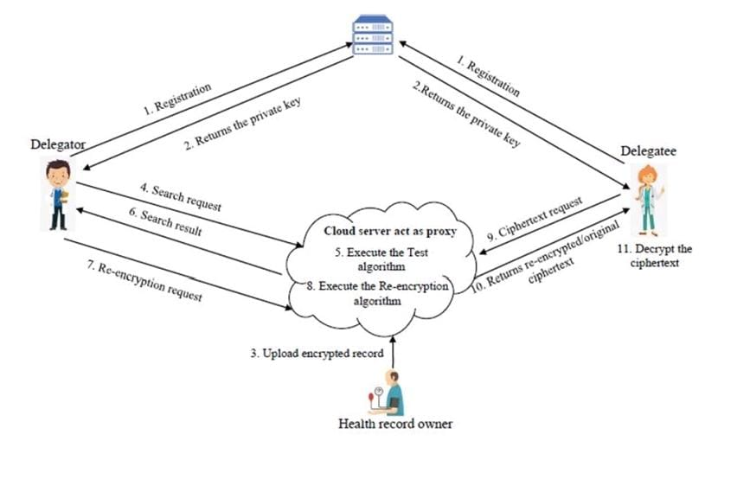
SYSTEM ARCHITECTURE

Slide 9
MODULES
Health Record Owner: Controls and owns encrypted health data.
Health Record Owner: Controls access to personal data.
Delegator: Assigns access; retains responsibility.
Delegatee: Accesses shared health records securely.
PKG: Issues and manages cryptographic keys.
Cloud Server: Stores encrypted data; supports secure search & sharing.

Slide 10
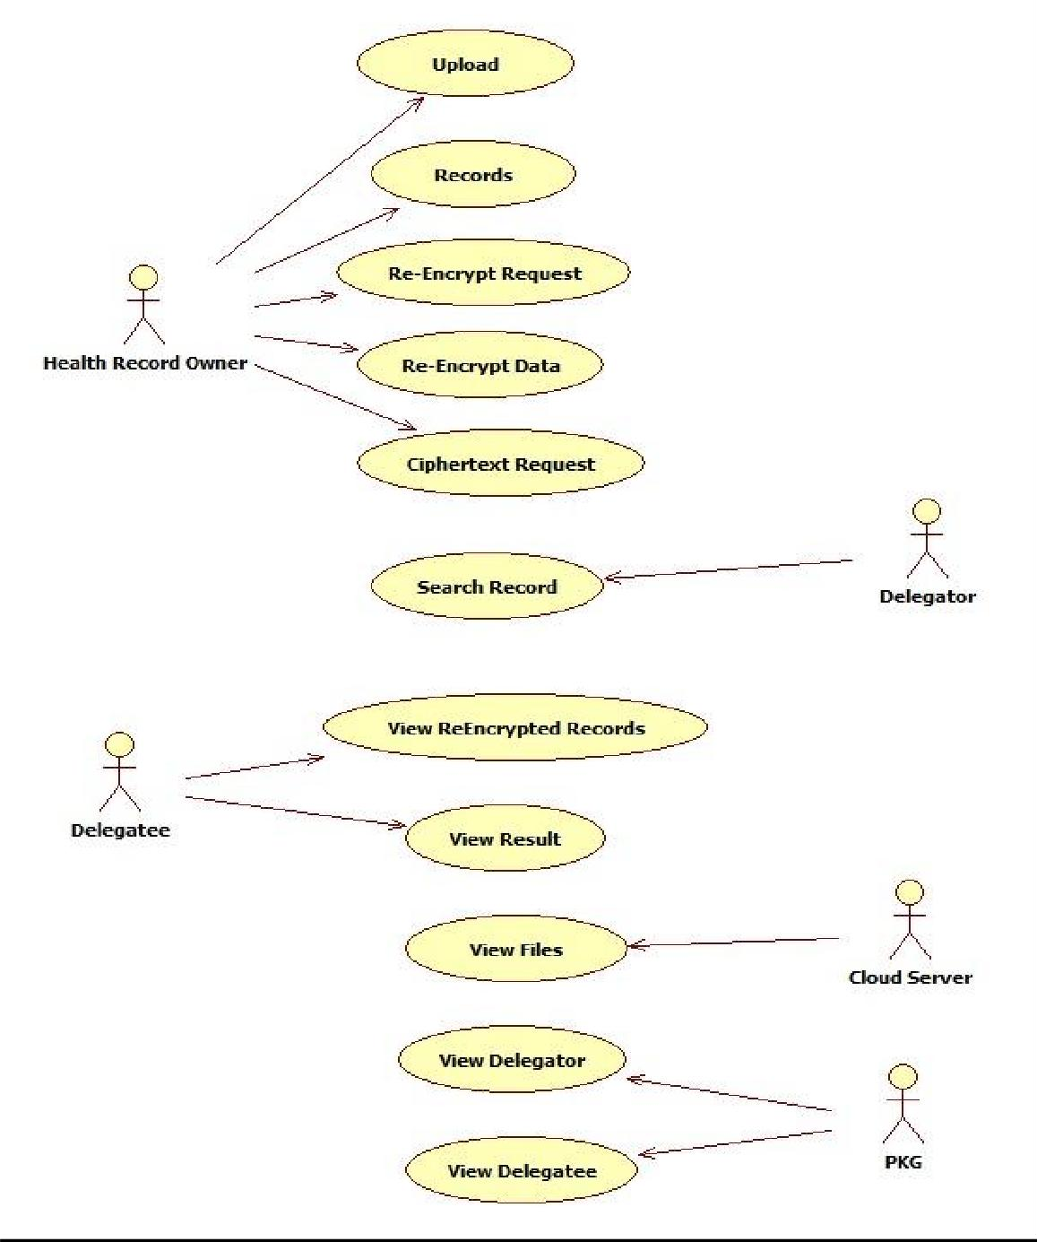
UML DIAGRAMS USE CASE DIAGRAM

Slide 11
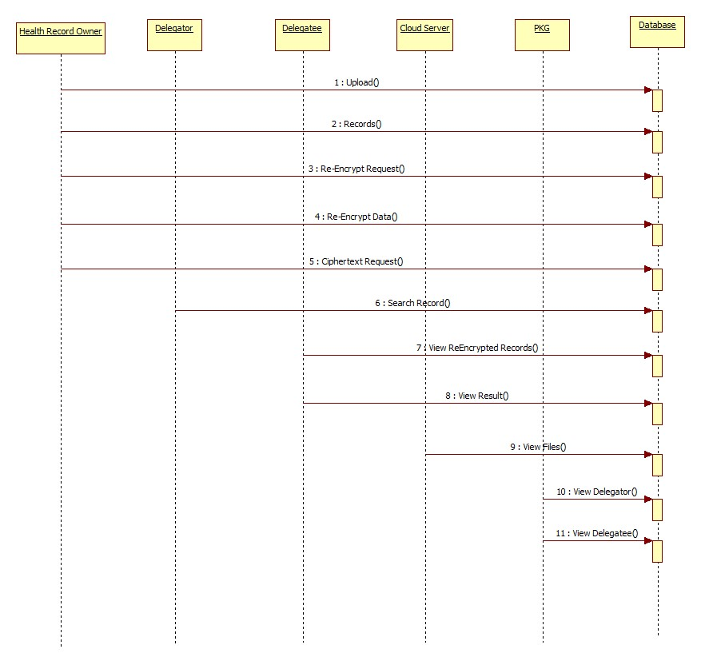
SEQUENCE DIAGRAM

Slide 12
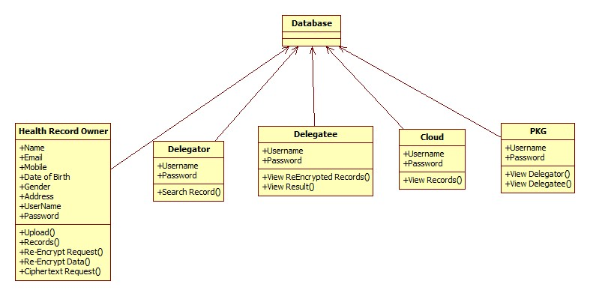
CLASS DIAGRAM

Slide 13
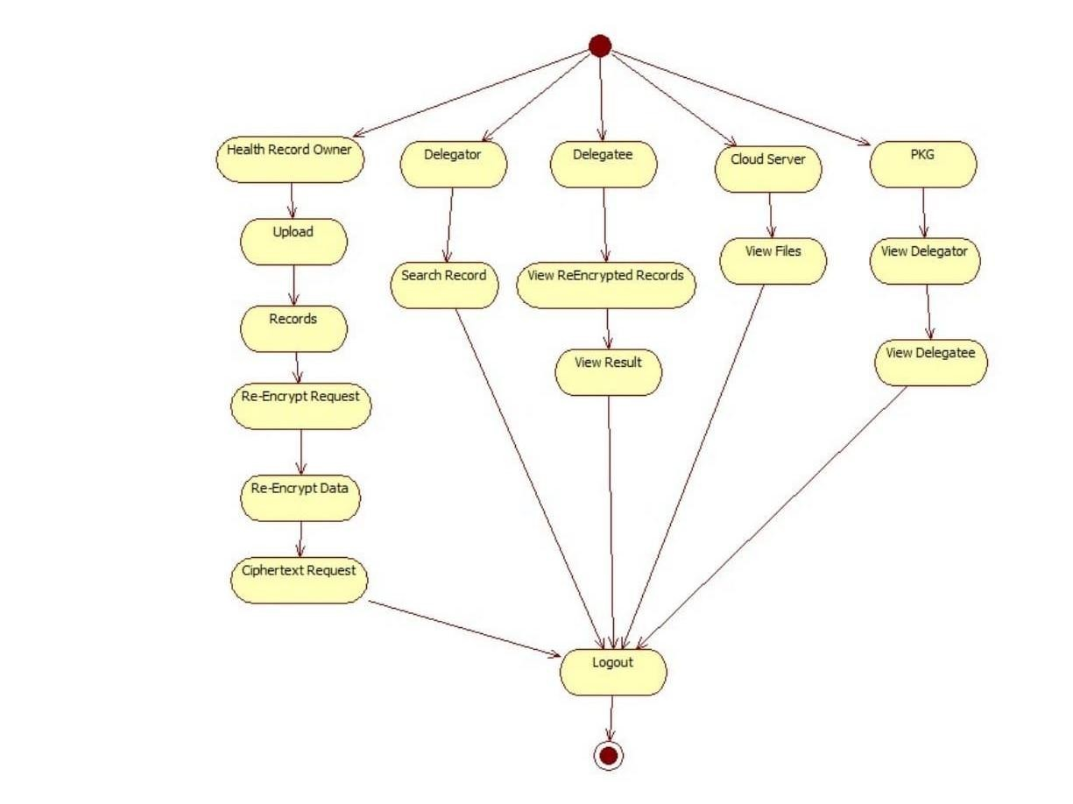
ACTIVITY DIAGRAM

Slide 14
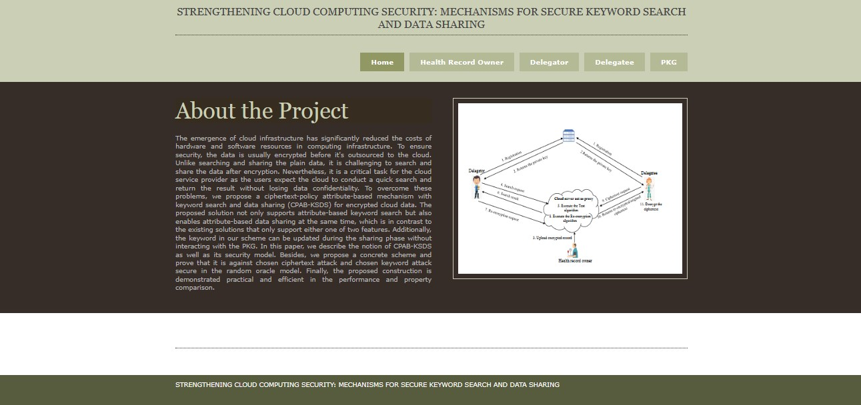
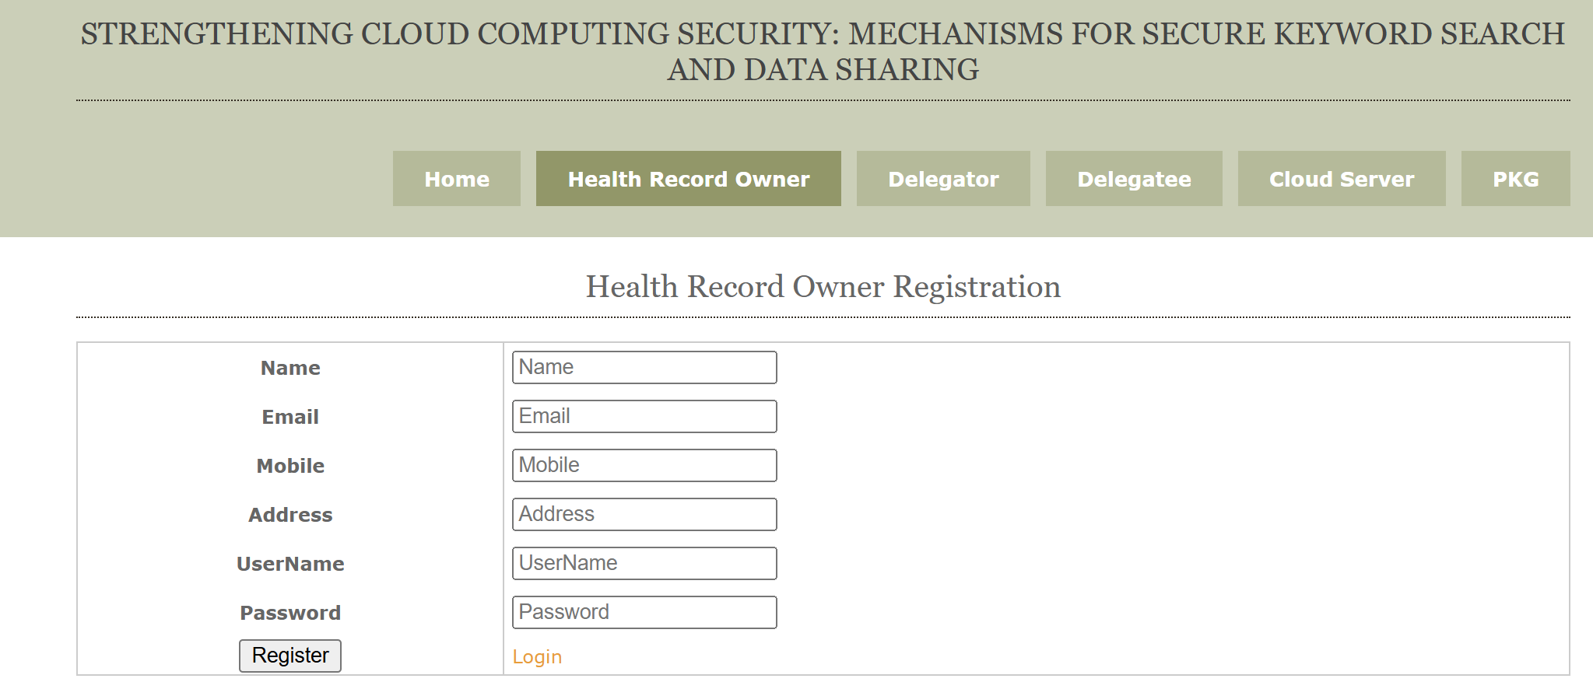
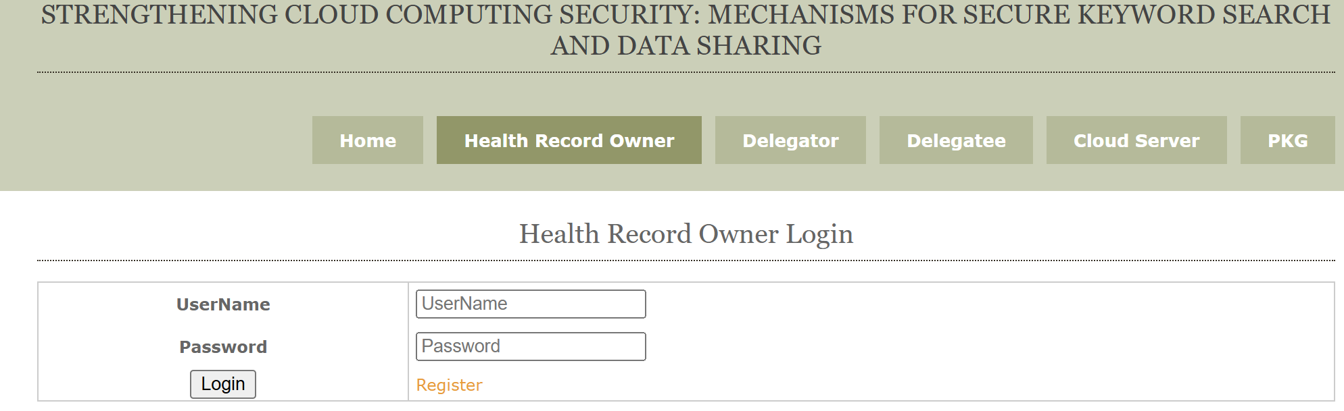
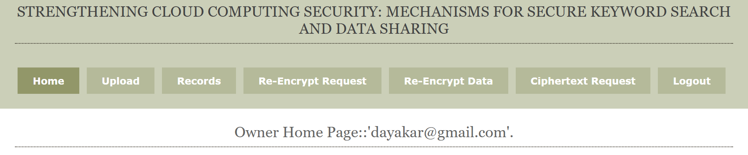
SCREENSHOTS OF EXECUTION

Slide 15
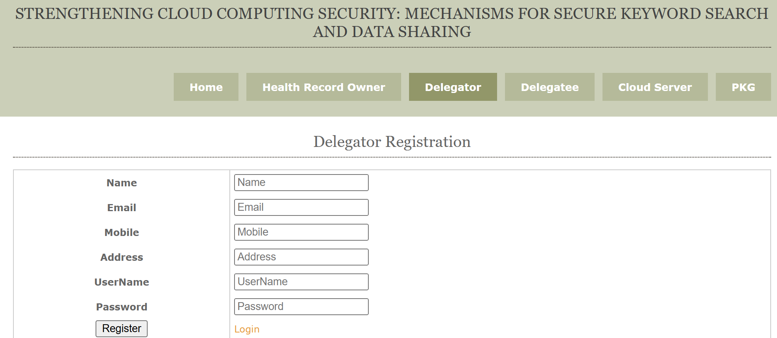
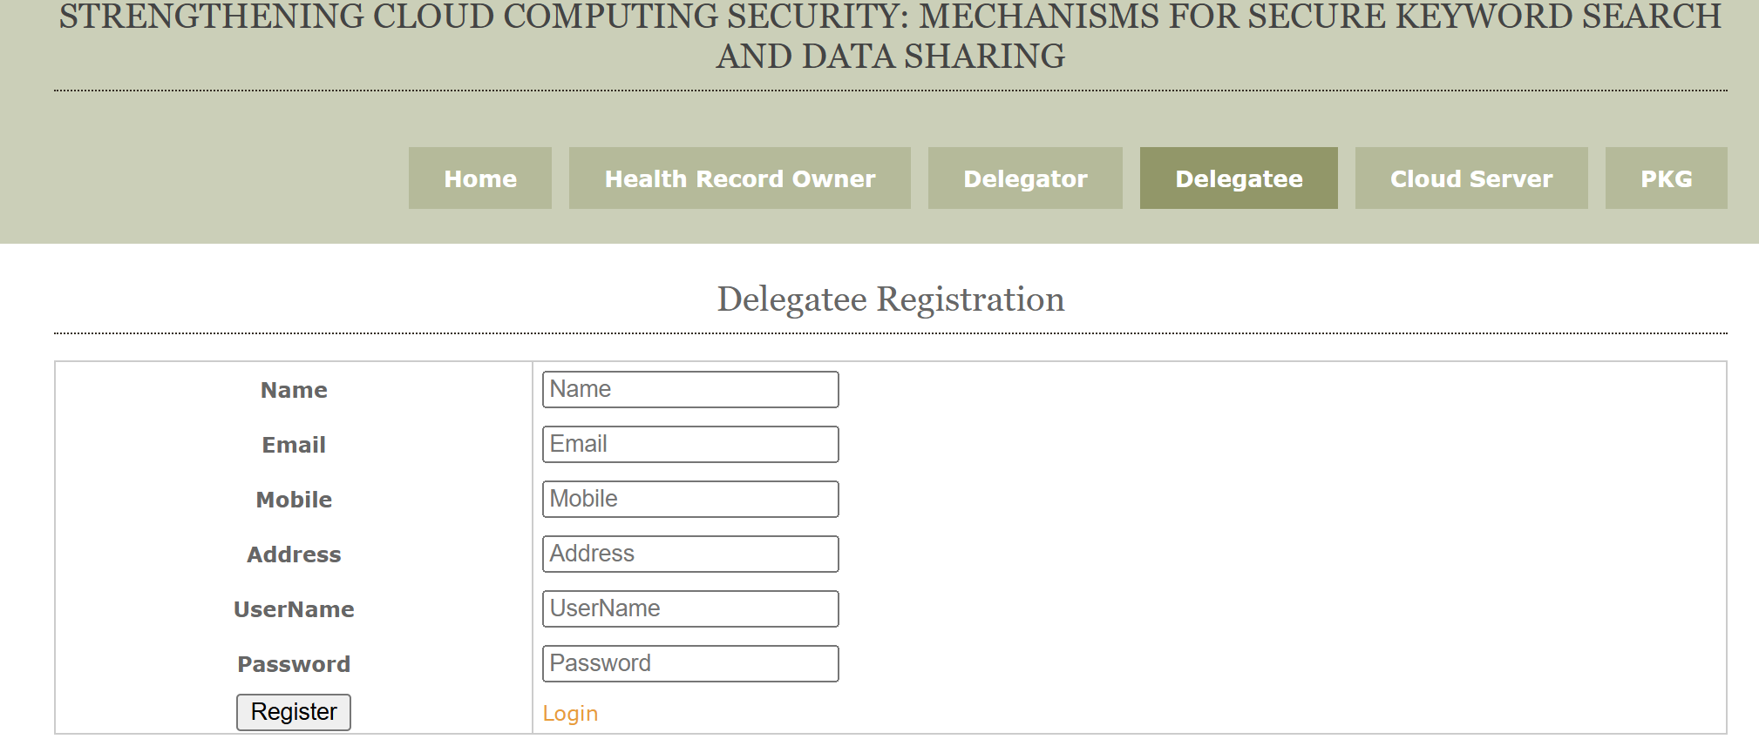
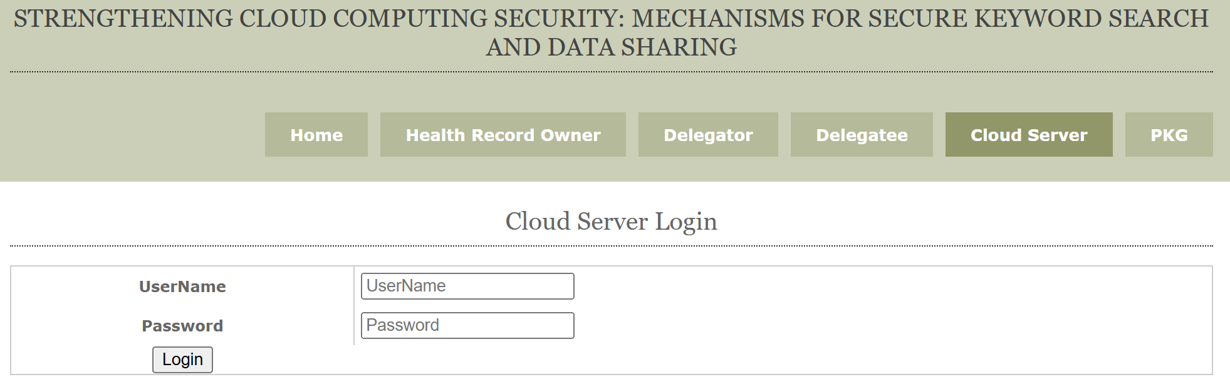
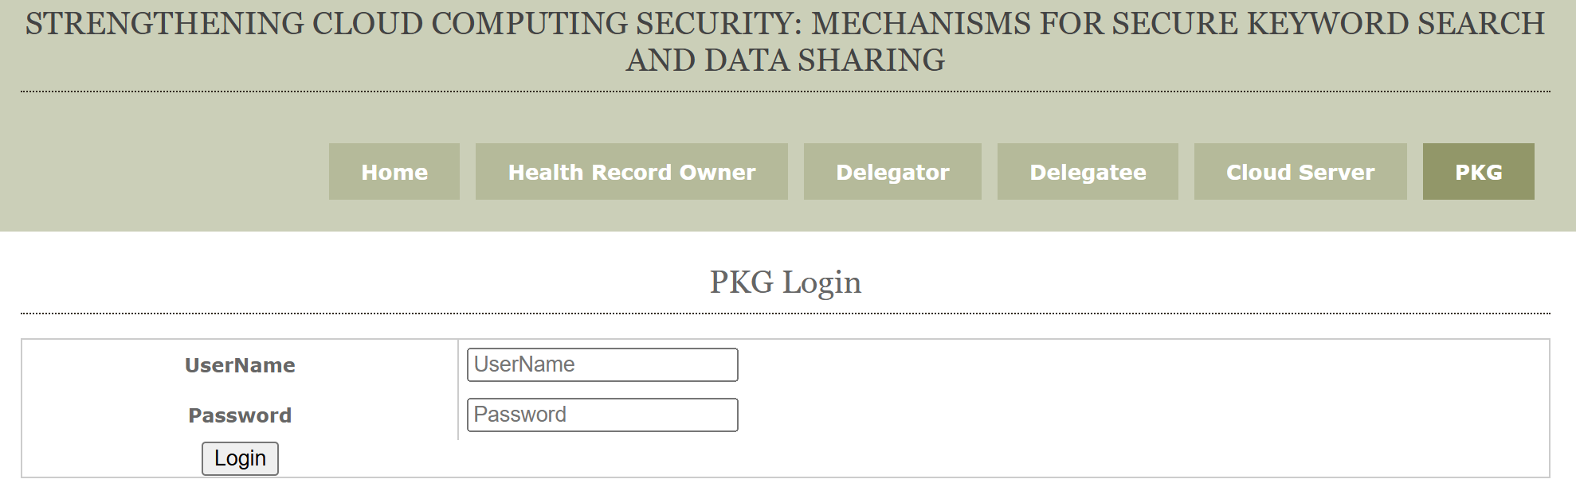

Slide 16
CONCLUSION
Proposed CPAB-KSDS for secure keyword search and data sharing in the cloud.
Ensures CCA-security
Demonstrates strong efficiency, practicality, and scalability.
Addresses prior limitations and opens scope for advanced secure search schemes.

Slide 17
THANK YOU…!!

